Slide 1


Gradients
A combination of multiple colors which come one after another in a flow

Slide 2
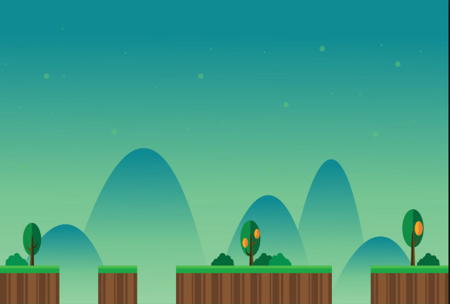
When to use the Gradients?
Virtual Backgrounds

Slide 3

When to use the Gradients?
Interactive backgrounds in websites

Slide 4

Types of Gradients
Linear Gradient
Occupies the whole color space either vertically or horizontally. In the above diagram, it is horizontal.

Slide 5

Types of Gradients
Ends with the green
Starting from red
Radial Gradient
A radial gradient starts generating from its center

Slide 6
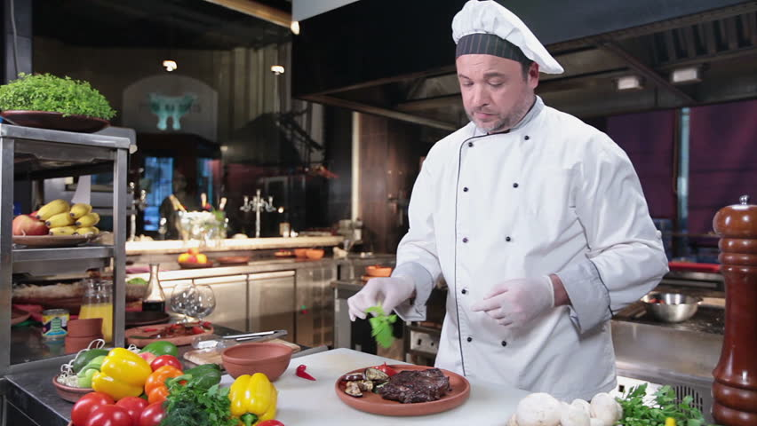
Using gradients

Slide 7
Using gradients (Linear)
to bottom
background-image: linear-gradient(direction, color 1, color 2);
background-image: linear-gradient(to bottom, red , yellow);

Slide 8

Using gradients (Linear)
to right
background-image: linear-gradient(direction, color 1, color 2);
background-image: linear-gradient(to right, red , yellow);

Slide 9
Using gradients (Radial)
background-image: radial-gradient(shape size at position(Optional), start-color, ..., last-color);
background-image: radial-gradient(red, yellow, green);

Slide 10

Using gradients (Radial)
background-image: radial-gradient(shape size at position(Optional), start-color, ..., last-color);
background-image: radial-gradient(red 5%, yellow 15%, green 60%);
//Specify a color range

Slide 11
A fast and professional way!
http://www.colorzilla.com/gradient-editor
http://angrytools.com/gradient

